Slide 1
PRESENTATION TITLE
Subtitle

Slide 2
PRESENTATION TITLE
Subtitle

Slide 3
PRESENTATION TITLE
Subtitle

Slide 4
TITLE

Slide 5
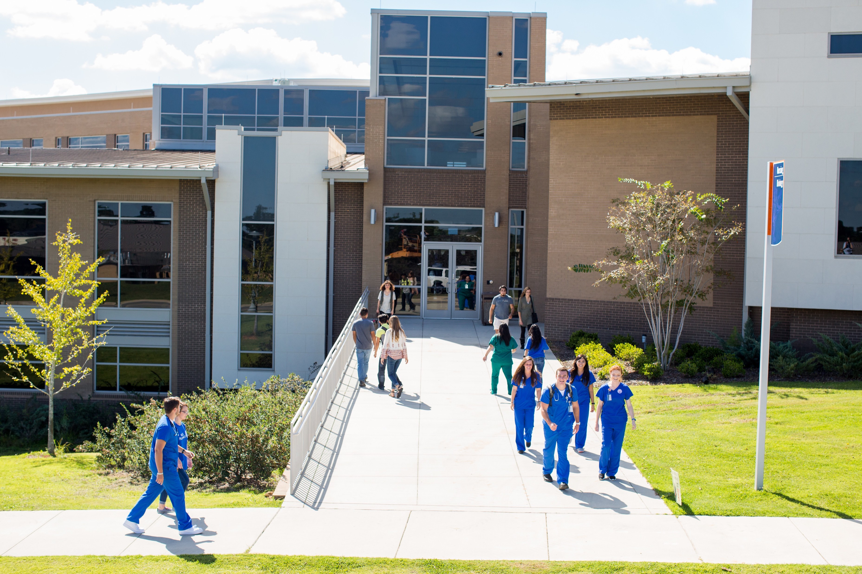
PROGRAMS
Business
Criminal Justice
Graphic Art & Design
Liberal Arts/General Studies
Paralegal
Pre-Education
Religious Studies
Computer Science
Mathematics
Engineering
Pre-Engineering
Child Development
Dental Assisting
Dental Hygiene
Diagnostic Imaging
Diagnostic Medical Sonography
Emergency Medical Services
Health Information Technology
Medical Assistant
Medical Laboratory Technician
Nursing
Occupational Therapy Assistant
Physical Therapist Assistant
Polysomnographic Technologist
Respiratory Therapy
Sports Medicine
Advanced Automotive Services
Agriculture Production/Horticulture
Aviation/Flight Technology
Culinary Arts
Diesel Technology
Engineering Technology
HVAC & Refrigeration
Machine Tool Technology
Mechatronics, Electronic & Robotics
Salon and Span Management
Welding

Slide 6
ACCOLADES

Slide 7
CONTACT
PHONE
EMAIL
Connect With Us
wallacestate.edu

